Slide 1





Kranthi Bannuru
Gary Lee
Alex Xie
Susan Song
Vincent Zhang
Vignes Muthukumar
TEAM 3
7 November, 2018

Slide 2
Agenda
Case Study - Alex
Problem statement + Market size (DSTM) - Susan
Need Statement (and Spec)
Proposed Solution (detailed description) - Gary (Prototype design added - Kranthi, Pls review)
Competition & Value Proposition - Kranthi
Business Model and Reimbursement - Vincent
Sales and Marketing Plan (Brief) - Vincent
Financial Projection and Funding - Vincent
R&D Plan and Clinical Trials - Alex
Regulation, Challenges and Risks (including IP) - Vignes, Kranthi
Plan going forward - Vignes
Team - Kranthi

Slide 3
Case Study

Slide 4
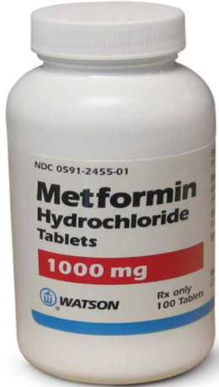

“Yes, doc. I take your medicine everyday!”

Slide 5
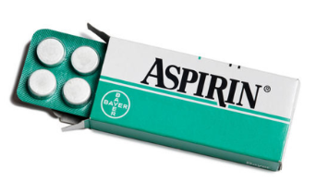
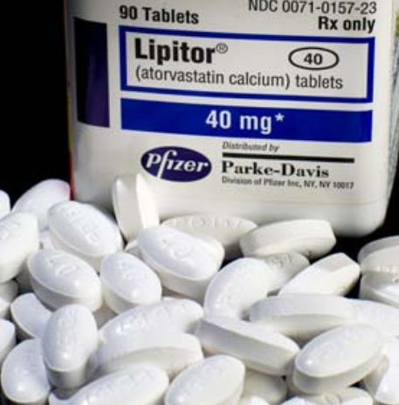
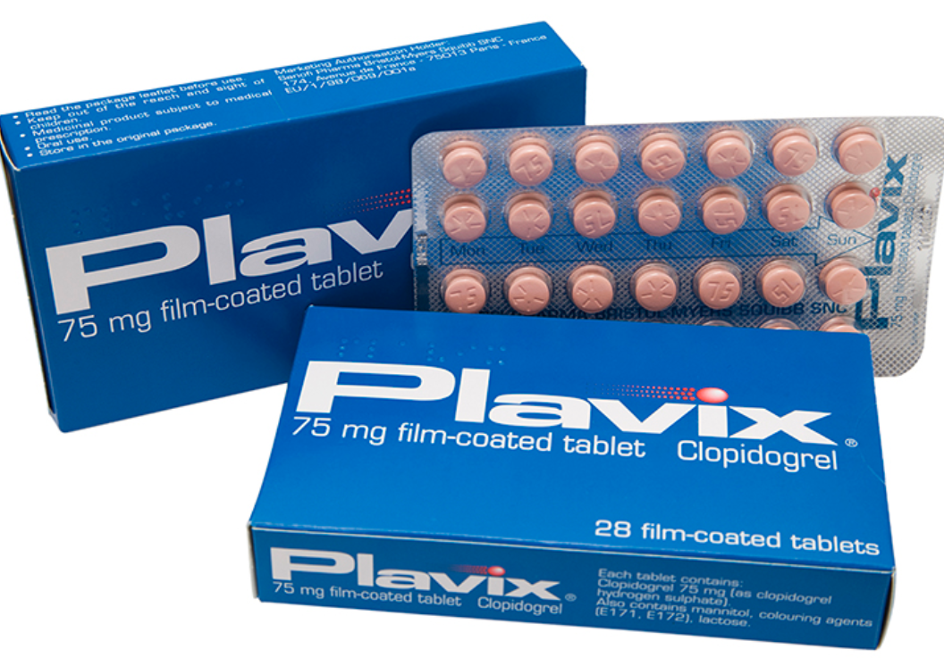
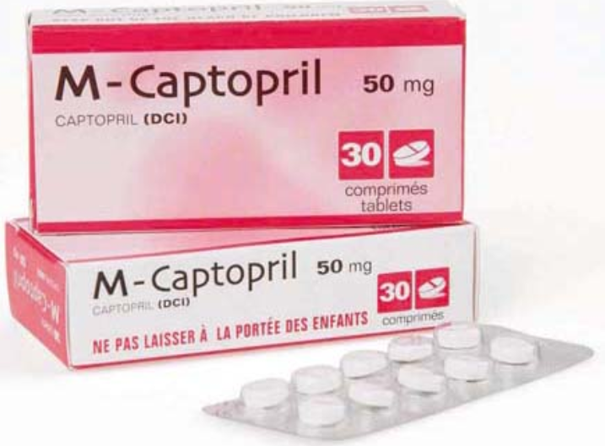
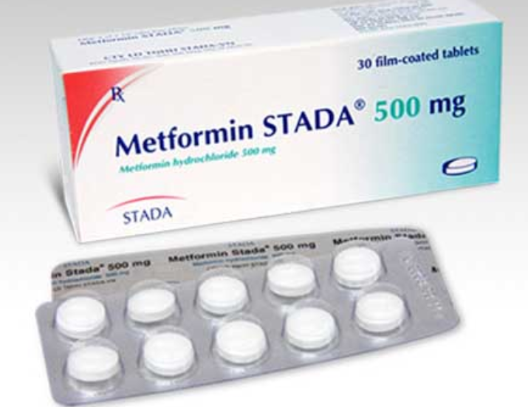
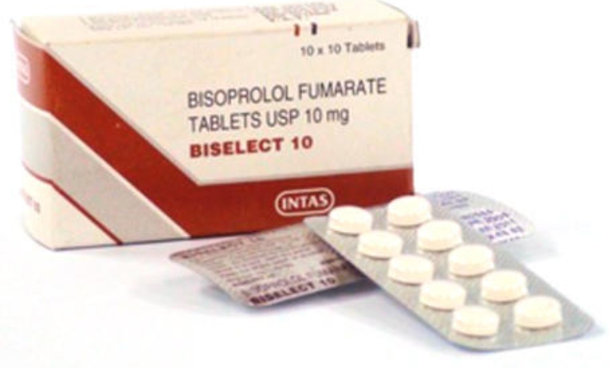
“Doc, how many of the white round tablet should I take?”
White round tablet
白色药元 Tablet Putih
White tablet
白色药元
Tablet Putih
Re round tablet
红色药元
Tablet Merah
White round tablet
白色药元
Tablet Putih
White round tablet
白色药元
Tablet Putih
White round tablet
白色药元
Tablet Putih

Slide 6
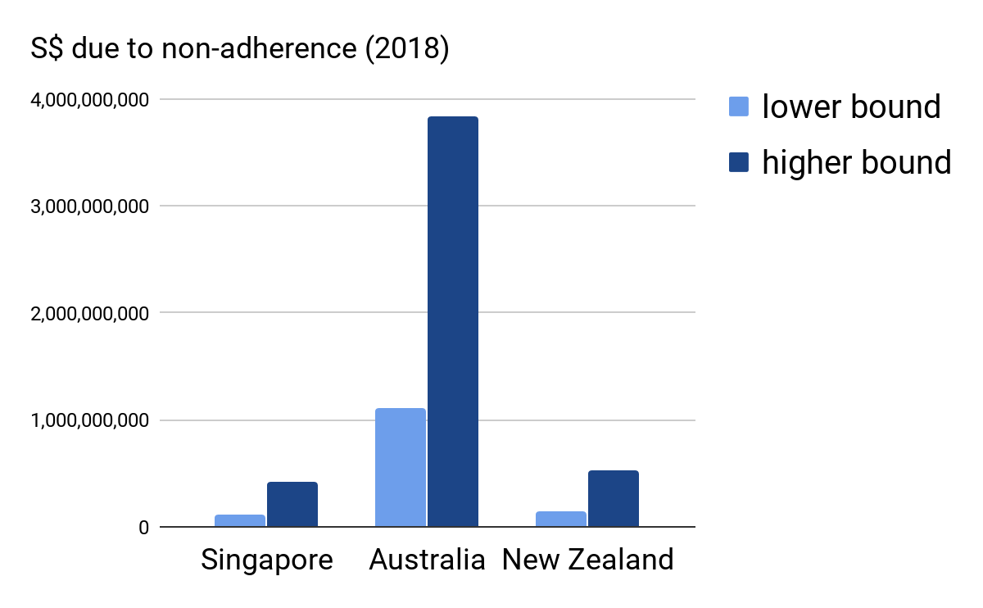
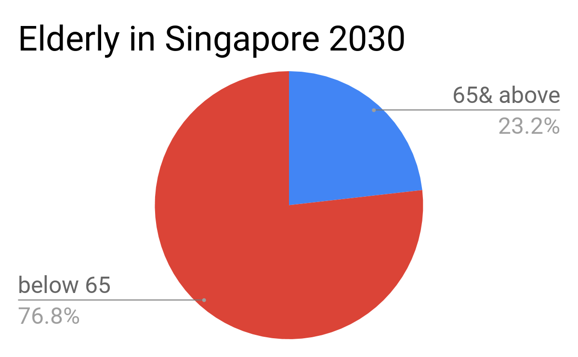
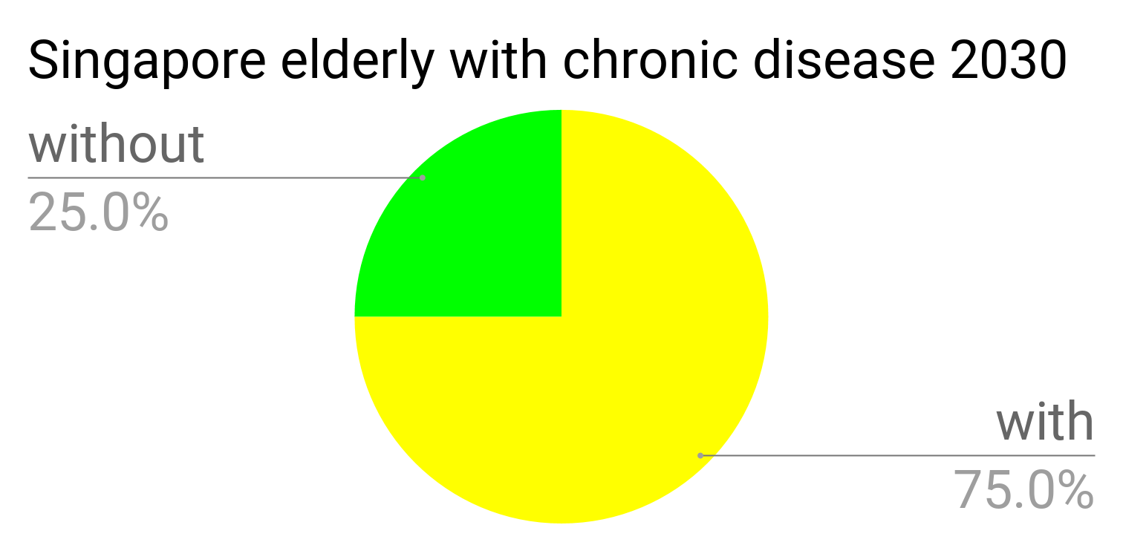
Market Size: over 1 Billion SGD annually

Slide 7
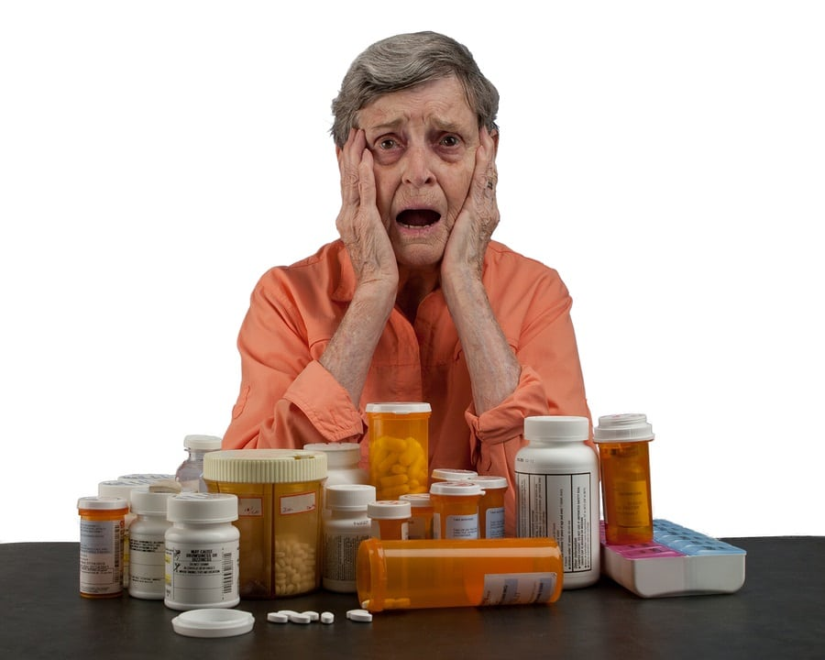
Need Statement
A hassle-free way to manage medications in elderly outpatients with polypharmacy (>3) to improve compliance to treatment

Slide 8
Need Specification
Must-Have Criteria | Good-to-Have Criteria
Easy to use | Product does not cause too much disruption to status quo
Prevent confusion when patient is taking multiple medications | Encourage intrinsic motivation to be adherent
Reduce the workload for patients/caregivers to sort medication | A feedback mechanism for doctors to review past medication
Provide time-specific reminders that are customizable according to the patient’s needs | Portability for more mobilised patients
Affordable for the targeted group

Slide 9
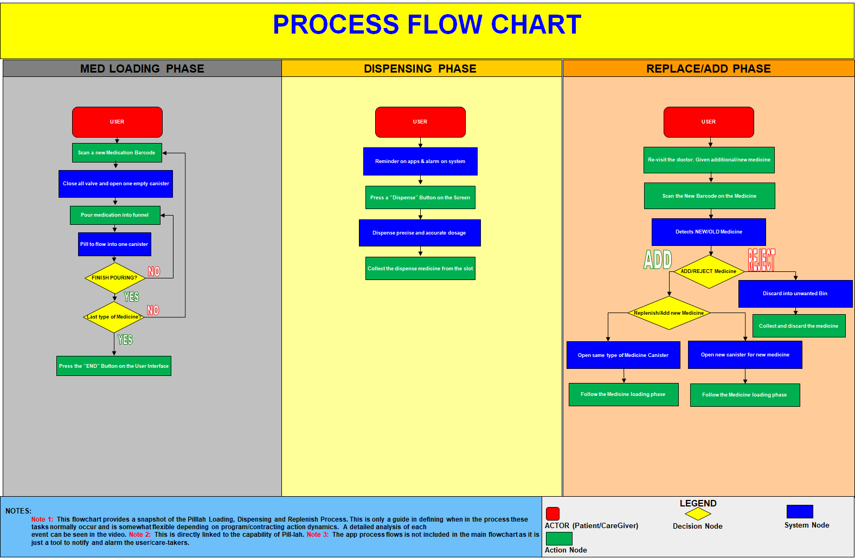
Proposed Solution: PILL-lah WorkFlow

Slide 10
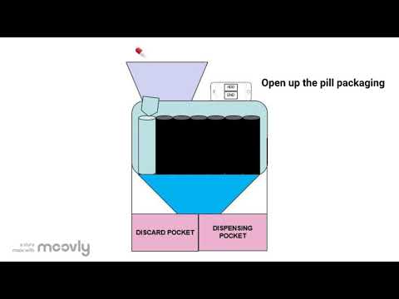
Animation and Process description

Slide 11
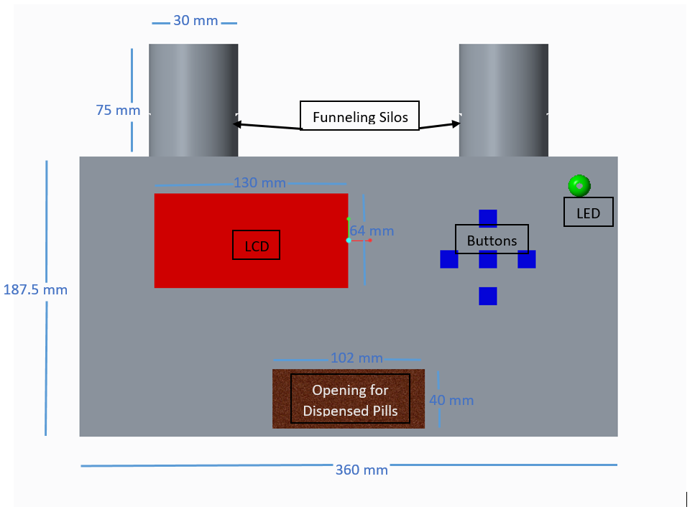
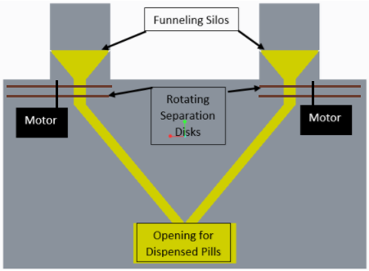
Prototype Design
Front View Cross-sectional view

Slide 12
Value proposition
A seamless and convenient smart pill dispenser with inbuilt scan feature that sorts, reminds and dispenses pills for the elderly, with minimal effort and low cost without the need for manual information input
Customer Jobs
Pains
Gains
•Follow regimen/dosage
•Sorting
•Remind to take
•All pills on time
•Track Adherence profile and alerts
•Multiple pills and dosages
•Confusion with brand names/API
•Forgetfulness to take
•Taking one instead of other
•No need to read or remember
•Dynamic number
•Dispense all pills at given time
•Alert when wrong medicine taken
•Retrieve intake profile
•Cheap and Easy
Existing products/solutions
Pain relievers
Gain Creators
Pillpresso
Adheretech
Lumma
iLid Rx
Single hopper input
sort and dispensing mechanism consolidated process
LED and voice reminders
Simple scan
Single hopper input
Auto sort and dispensing
Data tracker

Slide 13
Business Model
Model of selling: monthly subscription
Pricing: USD$39.99/month (vs one-time at $200~300 and sub. ~$50/month)
Segment specific: elderly patient (price sensitive)
Flexibility
Recurring revenue
Customer loyalty (eg. Discount for # yrs of continued sub)
Flexible for patients
Connected with patients
Sustainability
Customer Retention

Slide 14
Reimbursement
Singapore has a multi-layered payment system
Government
Senior’s Mobility and Enabling Fund: support for seniors to age in place within the community. Fund home care including HOME HEALTHCARE ITEMS .
Subsidies For Government-Funded Intermediate and Long Term Care Services: if patient is already on long term care for chronic conditions and requires medication
Co-payment - amount depending on the level of subsidy that MOH is willing to provide
No reimbursement codes for private insurance as yet
The inability to offset the price may be frustrating for some. But with the peace of mind the product offers and future potential tie-ups with insurance firms, there may be a way to make the product attractive in terms of reimbursement.

Slide 15



Sales and Marketing Plan
Direct Sales Force
Referral by Clinicians
Distributors
Elderly patients
Aim to relieve burden for caregivers
Targeted
Segment
Key
Sales
Strategies
Free installation/setup service
Informal caregivers
(eg. offspring)
Trial with money-back
Caregivers in institutes
(eg. nursing home)
Discount with continuous subscription

Slide 16
Ops Plan, Financial Projection and Funding
Seed + AI: 80K
Series A: 500K
Series B: 3 mil
Total capital investment: ~4 mil USD
Years to profitability:
4~5 years
Growing SG customer base
Expansion in AU
Clinical trials
Product refining
Salesforce gathering
Available to market (SG)
Team formation
Proof-of-concept
Foundational IP
Prototyping
R&D
Profitability
2018
2019
2020
2021
2022
2023
2024

Slide 17
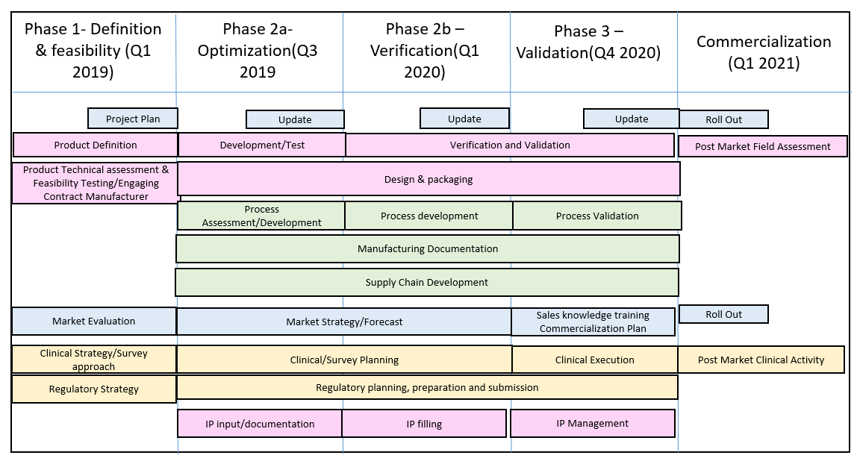
R&D Plan/Product Development Roadmap

Slide 18
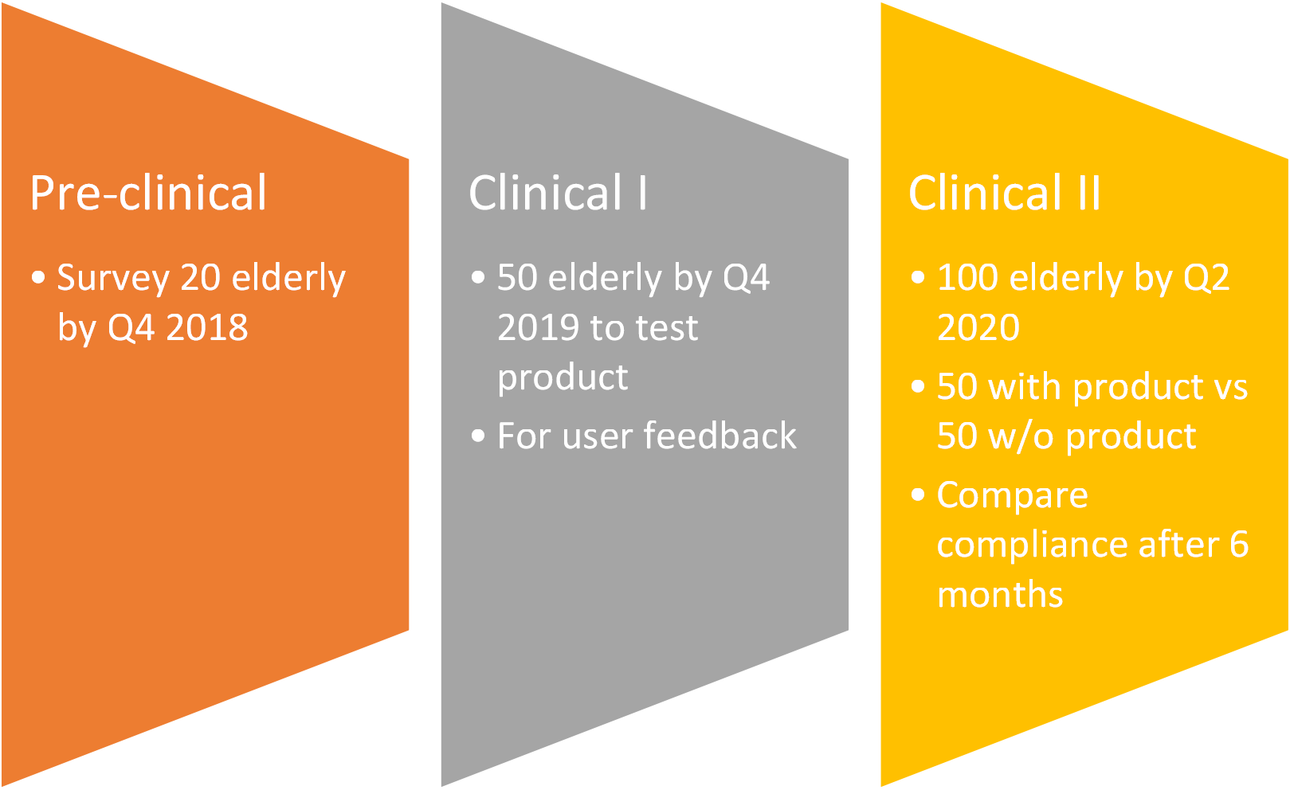
Clinical Trials

Slide 19
Regulation
Purchase Relevant Standards
Implement Standards
Link up with SAC to find appropriate CABs
Accreditation and Regulatory Reviews
Standards as set by the International Standards Organization
Implement standards as specified in the guides so as to meet the requirements of Enterprise Singapore
Work with the Singapore Accreditation Council to find the most appropriate Conformity Assessment Bodies to accredit Pillah
Receive accreditation and leverage on standards to have better market acceptance and higher standards of quality with the ultimate aim of supporting consumer safety, public health and sustainability.
ISO 15378:2017
ISO 13485:2016
ISO 9001:2015

Slide 20
Risk, Challenges & IP considerations
Technical | User-friendly | Concern feedback from potential user
 | Cost/reliability | Contract manufacturer
Clinical | Multifactorial | Target on particular group
Regulatory | Clinical-care process | Collaboration with hospital
 | Patient information | Approval from MOH
IP | Multiple dispenser design | Closest (US20160346167A1)

Slide 21
Plans Moving Ahead
2019
2020
2021
2022
Product optimization and verification
Proof of concept:
Pilot studies
Pivotal clinical trials to prove efficacy
Process Development kiv Standards
Linking up with hospitals & polyclinics
IP input and documentation
Process Validation
Supply Chain Development
Regulatory submissions
Design and Packaging
Salesforce recruitment and training
Product Introduction and Sales Initialization (25 months after concept generation)
Product to become profitable

Slide 22
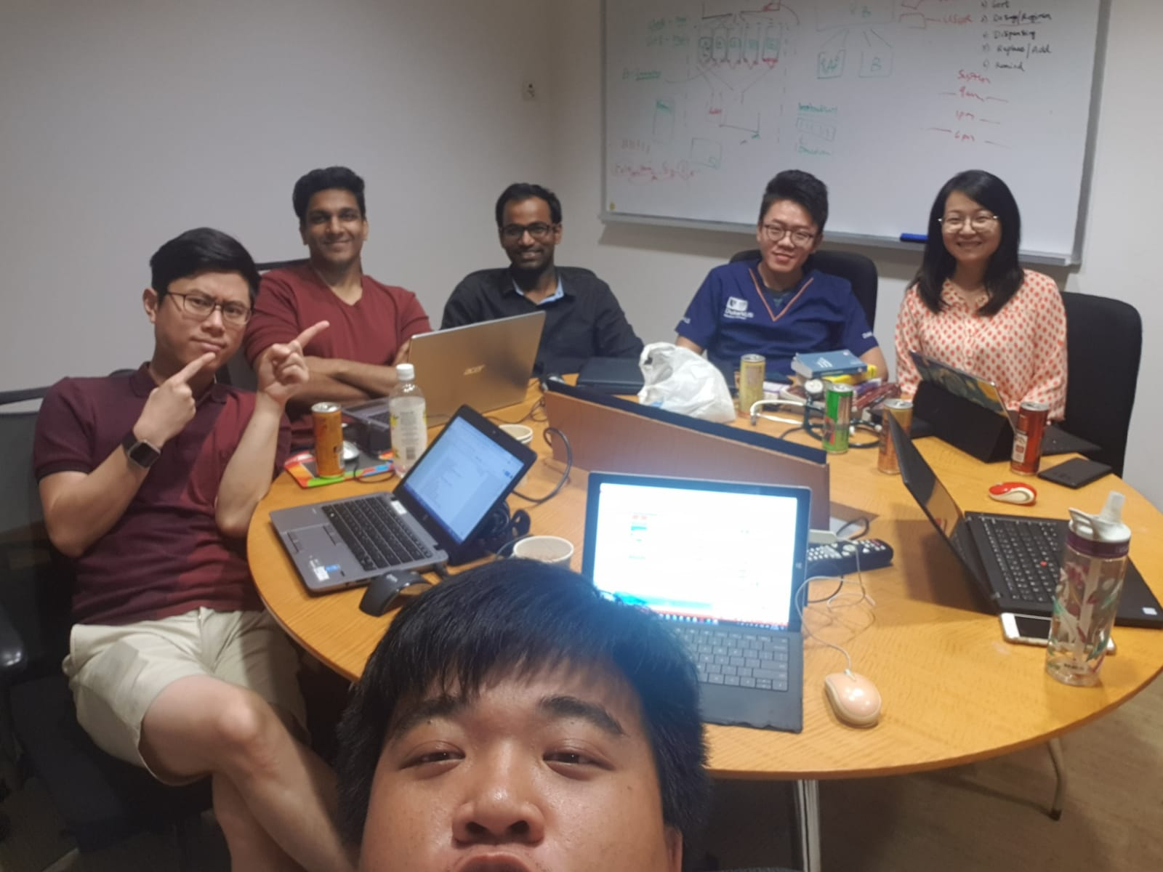
Team
Vincent Zhang (Global Business Director), Vignes Muthukumaran (Head of Operations), Kranthi Bannuru (Chief Technology Officer), Alex Yufei (R&D & Clinical Trials Director), Susan Song (Chief Design Director), Gary Lee (Chief Executive Officer)

Slide 23
Q & A

Slide 24
Intellectual Property (Optional)
*only highlight parts relevant to our product

